Slide 1
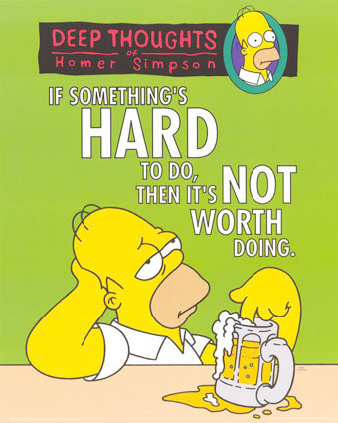
Apostrophe

Slide 2
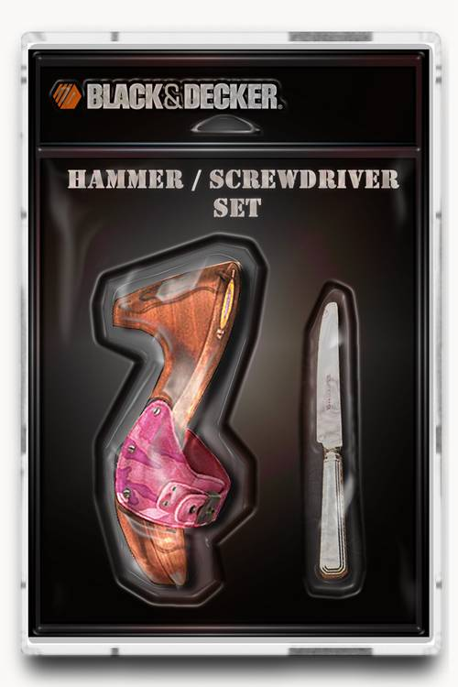
An apostrophe ( ' ) is a tool in English grammar. It's not the case that certain words contain an apostrophe - we use it to show either:

Slide 3

A contraction
A contraction (one or more letters missing to shorten the word) such as:
Hasn’t
Has not
Can’t
Didn’t
Can not
Did not
There’s
There is
We’re
We are

Slide 4
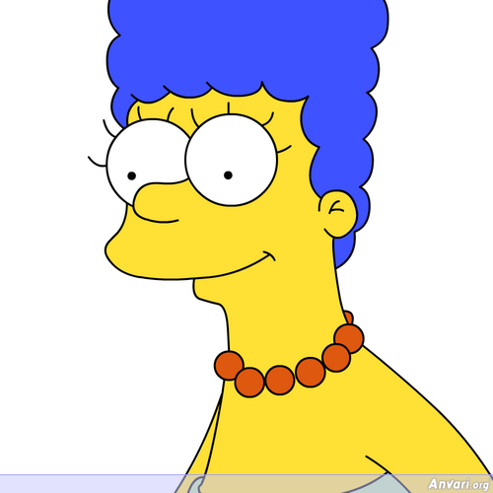

Possessive (belonging)
Norwegian has sitt/sin(e)
Molly's cat (The cat belongs to Molly), Marge Simpson’s hair, Lisa's book, etc.

Slide 5
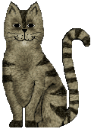
Molly’s cat
One Molly and one cat! The cat belongs to Molly.

Slide 6
Molly’s cats
One Molly, several cats. The cats belong to Molly.

Slide 7

Molly’s cat’s bowl
The cat belongs to Molly. There is one cat and one bowl. The bowl belongs to the cat.

Slide 8
The cats
’ bowls
The bowls belongs to several cats. Therefore the apostrophe comes AFTER the ”s” because it shows more than one cat - PLUS belonging.

Slide 9
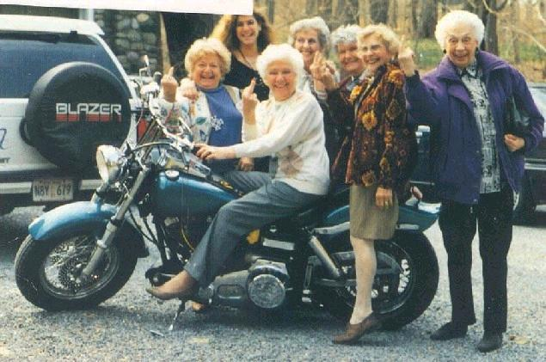
Test yourself
The lady’s motorbike?
The ladys’ motorbike?
The ladies’ motorbike?

Slide 10
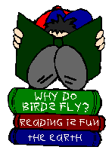
How many are correct?
Tony’s reading his book.
These books’ are Tonys.
He’s reading carefully.
Tony has lot’s of books.
He’s books are interesting.
These books are Tony’s.

Slide 11

BUT .........
It’s
”It’s” is always a contraction of ”it is” and never has a possessive apostrophe.
It’s always good to see you. The dog wags its tail every time you visit us.

